Slide 1
Case Study on Tracking SW Tickets and Projects.
Overview of the case study
Analysis process
Data wrangling
Exploratory data analysis
Limitations and recommendations
Marwan Diab
Marawan. Diab@gmail.com | 01026252078 | https://www.linkedin.com/in/marwan-xdiab

Slide 2




Overview
About:
recorded staff hours on projects and open SW tickets that need to be resolved
Purpose :
To enhance project management, resolve certain data discrepancies, find trends and outliers, and establish SLA for tickets. So that we may respond to inquiries like:
Check deviation between actual , budgeting and forecast hours.
How many tickets are assigned to each project
How many are overdue?
Determine the SLA for tickets based on severity and project duration.
Marwan Diab
Marawan. Diab@gmail.com | 01026252078 | https://www.linkedin.com/in/marwan-xdiab

Slide 3





Analysis process
Research and Investigate
Exploratory Data Analysis
Identify trends, patterns, and outliers, and use visualisations to derive clear insights from data. (Using Python)
To provide data-based answers, I had to ask some questions. There were several novel ideas Ex: The SLA for tickets.
Data Wrangling
Data Visualization
Finding, purifying, and manipulating data Identification of KPIs, SLAs, and data limitations.
(Using Python)
Create a dashboard and information and data representations
(Using Power BI and Power Point)
Marwan Diab
Marawan. Diab@gmail.com | 01026252078 | https://www.linkedin.com/in/marwan-xdiab

Slide 4
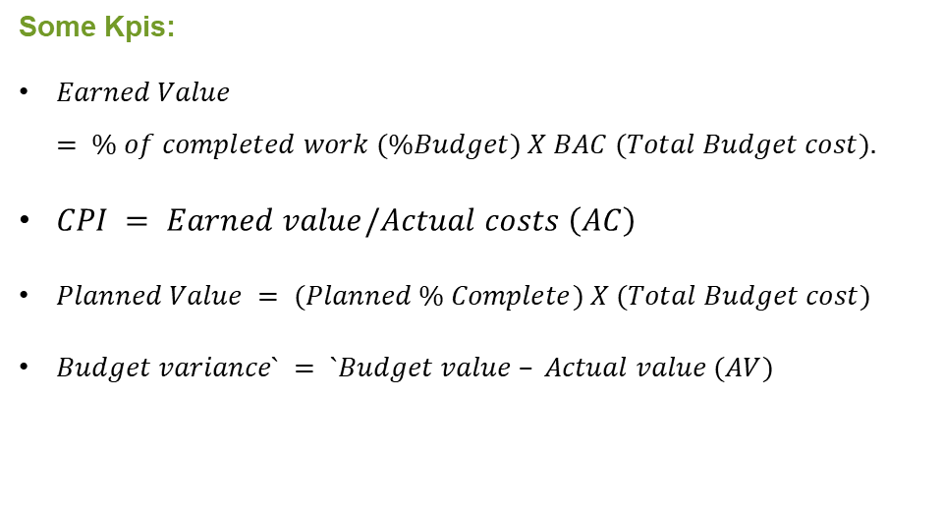
Data Wrangling
Data Cleaning & Manipulation
In this phase, I examine and discover the data, looked for duplicates, nulls, the data type, unique values, date limitations and Define KPIs .
Some outcomes:
Hours has 8 duplicated Data Point
All Department Has No Service type except "Internal Department“
Each project has approximately 7 milestones
Project Has Ticket: 8571
All Site Has Null Value ,Tickets are "Closed“
data available in the period from 2022_W24 to 2022_W42
Some Kpis:
$Earned Value = \% of completed work (\%Budget) X BAC (Total Budget cost).$
$CPI = Earned value/Actual costs \left(AC\right)$
$Planned Value = (Planned \% Complete) X (Total Budget cost)$
$Budget variance` = `Budget value – Actual value (AV)$
Marwan Diab
Marawan. Diab@gmail.com | 01026252078 | https://www.linkedin.com/in/marwan-xdiab

Slide 5
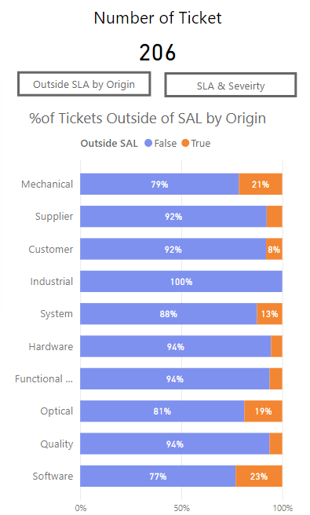
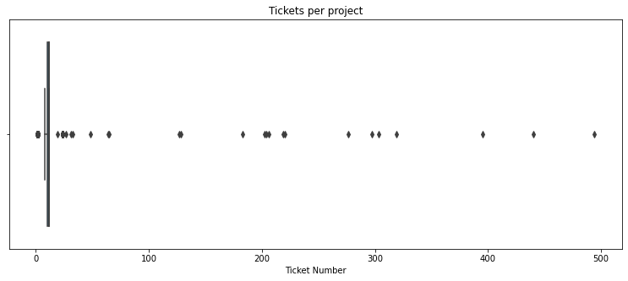
Exploratory data analysis
Outliers
SLA For Tickets
In addition to the degree of severity, if the ticket status is not closed , rejected, or cancelled at the time of delivery. They violate the Service Level Agreement (SLA).
Why?
The SLA helps the partner to remain focused on client requirements and needs. It outlines the specific scope and timing of what is to be provided to the client.
The overall trend of the data is consistent. It was interesting to note that all projects and tickets have almost the same proportions, but there are outliers where the average number of tickets is 12 per project, but it was discovered that there are outliers for projects with more than 400 .
Marwan Diab
Marawan. Diab@gmail.com | 01026252078 | https://www.linkedin.com/in/marwan-xdiab

Slide 6
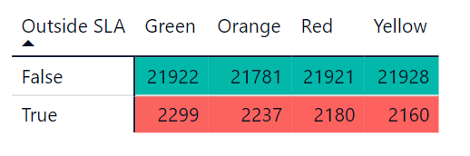
Limitations and recommendations
The dataset lacks critical information for identifying important patterns in the project management process, such as project completion time and ticket, as well as the percentage of what has been accomplished from the project in each week, the ticket. We have severity for each ticket, but priority is also critical for identifying fair SLA.
As indicated in the table above, even if tickets have varying degrees of Severity, the proportion of completion is nearly same, even though more work must be expended on higher-risk tickets than on others; possibly the priority function might clarify this issue.
Marwan Diab
Marawan. Diab@gmail.com | 01026252078 | https://www.linkedin.com/in/marwan-xdiab

